Slide 1
Modern Algebra By Prof.R.Gayathiri Devi Department of Mathematics

Slide 2
Abstract Algebra
Abstract algebra (occasionally called Modern algebra) is
the study of algebraic structures.
Albegraic structures include Groups, Rings, Fields, Modules, Vector space, Lattices and algebras.
Algebraic structures , with their associated homomorphisms, form mathematical categories. Category theory is a formalism that allows a unified way for expressing properties and constructions that are similar for various structures.

Slide 3
GROUPS
Groups are the most important structures in mathematics.
A group is a combination of a set S and a single binary operation *.
Conditions for form a group :
Closure axiom : a , b ∈ G⟹ a * b ∈ G
Associative axiom : ⩝ a , b , c ∈ G, ( a * b ) *c = a * ( b * c )
Identity axiom : e ∈ G , a * e = e * a = a , ⩝ a ∈ G
Inverse axiom : ${ a}^{−1}$ * a = a * $a^{−1}$
If it is an Abelian group the group must prove the Commutative axiom
Commutative axiom : a * b = b * a

Slide 4
RING
DISTRIBUTIVITY :
Distributivity generalises
the Distributive law for numbers.
(a+b) x c = a x c + b x c and
c x (a+b) = c x a + c x b,
and x is said to be
distributive over +.
A ring has two binary operators (+) and (x) , with x distributive over +.
Under the first operator (+) it forms a abelian group.
Under the second operator (x) it is associative , but it does not need to have identity , or inverse , so division is not required.
The additive (+) identity element is written as 0 and the additive inverse of a is written as –a.
EXAMPLE :
Commutative Rings
&
Non- commutative Rings

Slide 5
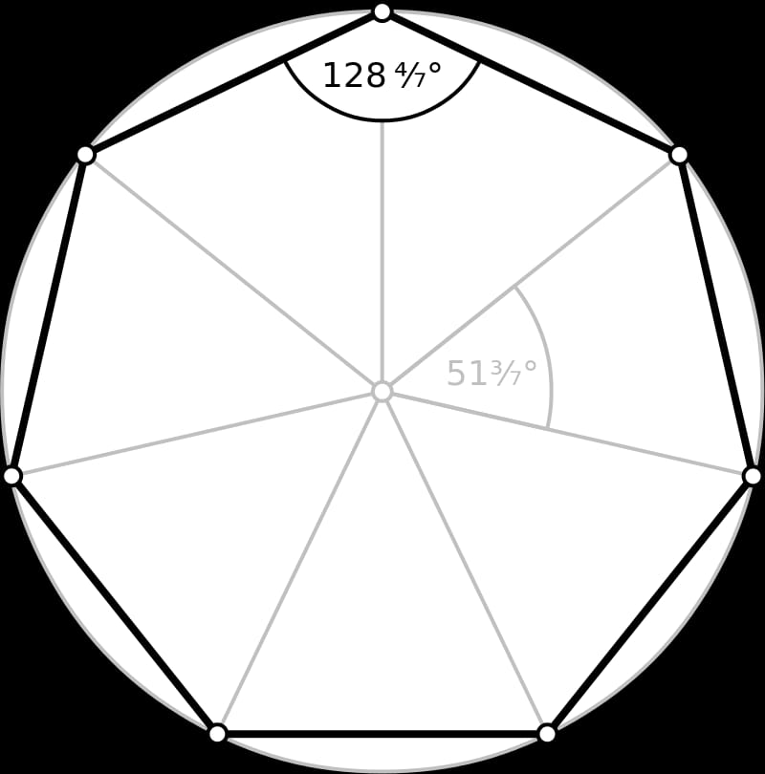
FIELD
A field is a ring with the additional property that all the
elements excluding 0 from an Abelian group under x.
The multiplicative (x) identity is written as 1 and the
multiplicative inverse of a is written as $a^{−1}$.
EXAMPLES :
The rational numbers , The real numbers & The complex numbers

Slide 6
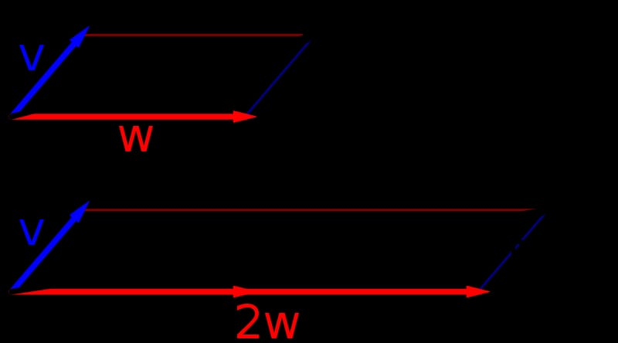
VECTOR SPACE
Let us consider the field F.
It consists of vectors . The Linear Independent
vector form a basis. The collection of basis is known us SPAN.
EXAMPLE :
Arrows in the plane
Euclidean vector

Slide 7
APPLICATION OF ABSTRACT ALGEBRA
MEDICAL SCIENCE
ENGNEERING
ASTRONOMY

Slide 8
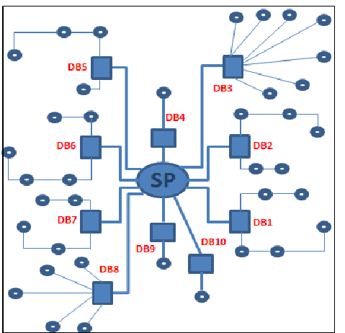
USES AND APPLICATION
ROBOTICS
NETWORK TOPOLOGY

Slide 9
THANK YOU

