Slide 1
Statistics For Business
By
Prof. S. Anitha
Department of Mathematics

Slide 2
Unit 5

Slide 3
Topics Covered
01
Probability Basics
02
Permutation and Combination
03
Addition Theorem of Probability
04
Multiplication Theorem of Probability

Slide 4
PROBABILITY
Chance of an event
OBSERVATION :
The result we see and recorded is called an observation
EXPERIMENT:
The process of making an observation is called an experiment

Slide 5
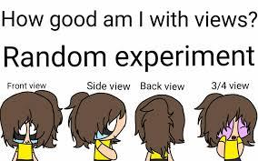
RANDOM EXPERIMENT
Is a process or procedure, repeatable under basically the same condition (this repetition is commonly called a TRIAL), leading to well defined outcomes.
It is random because we can never tell in advance what the outcome is going to be, even if we can specify what the possible outcomes are.

Slide 6
EVENT:
One outcome itself may be an event. Such events are called elementary events. More than one outcome constitute other events.
MUTUALLY EXCLUSIVE OUTCOME:
Two events are mutually exclusive if they cannot happen at the same time.

Slide 7
EXHAUSTIVE OUTCOMES:
Outcomes are said to be exhaustive when no other outcome is possible from the random experiment.

Slide 8
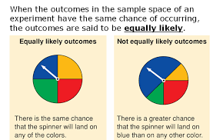
EQUALLY LIKELY OUTCOMES:
Outcomes which have equal chance of happening are said to be equally likely outcomes.

Slide 9
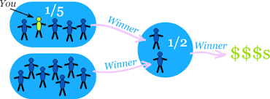
INDEPENDENT EVENTS:
Two events which do not affect the chances of each other are said to be independent events.

Slide 10
There are three different approaches
Classical Approach
Relative Frequency Approach
Axiomatic Approach
Commonly used approach - Classical approach

Slide 11
PERMUTATION
Permutation is an arrangement in a definite order.
Example 1 :
All possible permutations of three letters a,b and c talking two at a time are
ab; ac; ba; bc; ca; cb

Slide 12
Example 2:
How many vehicles can at the most be numbered as follows?
TN xx * xxxx
one or two An Alphabet one or two or digit number three or four digit number
Solution:
99 * 26 * 9999 = 2,57,37,426

Slide 13
COMBINATIONS
Combinations are groups. The members of each group are selected from the available members.
Example: Three members can be selected from the available three- A, B and C
Only one way is ABC

Slide 14
PERMUTATION & COMBINATION

Slide 15
Addition Theorem on Probability
Statement
If A and B are any two events of the sample space S and are not disjoint,
P(AUB) = P(A) + P(B)- P(A∩B).

Slide 16
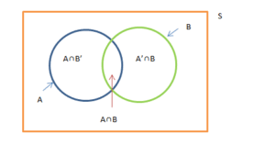

Slide 17
Example: From a pack of well shuffled playing cards, one card is drawn at random. What is the probability that it is a king or a spades ?

Slide 18
Solution: Let A be a King, B be a Spade; n = 52 To find: P(AUB) A, B and A∩B are 4, 13 and 1 respectively. P(A) = 4/52 ; P(B) = 13/52 ; P(A∩B) = 1/52 P(AUB) = P(A) + P(B) - P(A∩B) = 4/52 + 13/52 - 1/52 = 16/52 = 4/13

Slide 19
Multiplication Theorem on Probability
Statement:
If A and B are any two events which are not
independent,
P(A∩B) = P(A) P(B/A) if A precedes B
or
= P(A) P(A/B) if B precedes A

Slide 20
Example: From a bag containing 3 white and 5 red balls of identical size, two balls are drawn at random one after another. Find the probability of getting white balls in both the draws if the draws are (i) without replacement (ii) with replacement

Slide 21
Solution: Let A- white ball in the first draw; B- white ball in the second draw. To find P(A∩B) (i) P(A) = $\frac{3}{8}$ P(B/A) = $\frac{2}{7}$ P(A∩B) = P(A) P(B/A) = $\frac{3}{8}$$×$$\frac{2}{7}$ = $\frac{3}{28}$

Slide 22
(ii) P(A) = $\frac{3}{8}$P(B) = $\frac{3}{8}$ P(A∩B) = P(A) P(B) = $\frac{3}{8}$$×$$\frac{3}{8}$ = $\frac{9}{64}$

